Slide 1

Dash
Mockups & Screen Flow

Slide 2
Rounding and Status Management:
Systems-based Dashboards

Slide 3
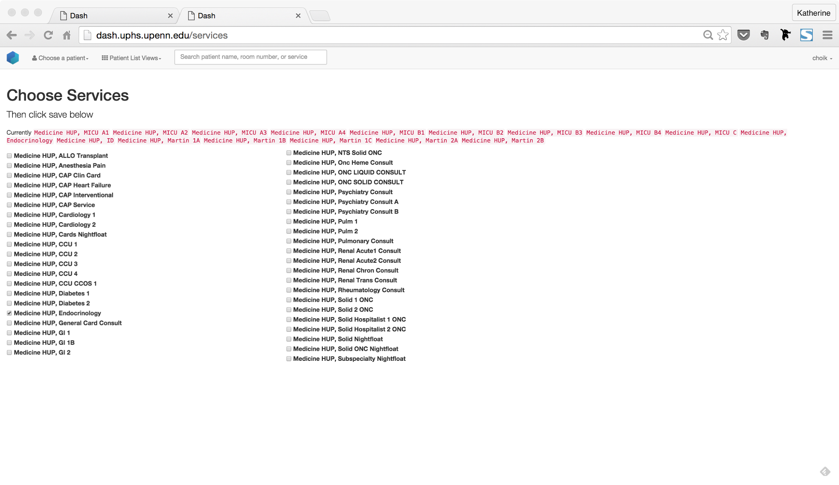
Service-based Lists

Slide 4
Dash - Features & Flow
Overview - Features & Flow

Slide 5
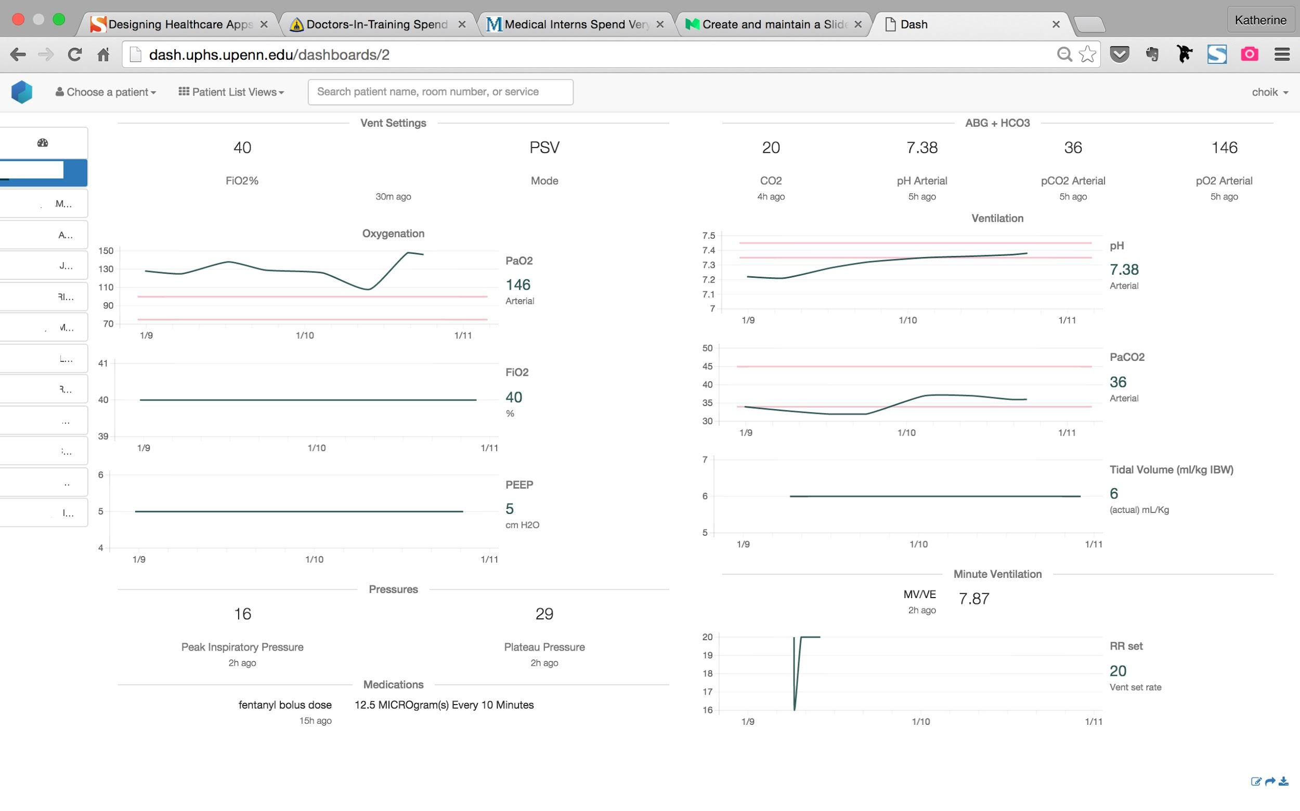
Decluttered
Key vent settings and actionable lab indicators are highlighted and can be read at a glance
Beyond a snapshot
Patient’s physiological response to dynamic vent settings can be tracked and interpreted visually
Pulmonary Critical Care

Slide 6
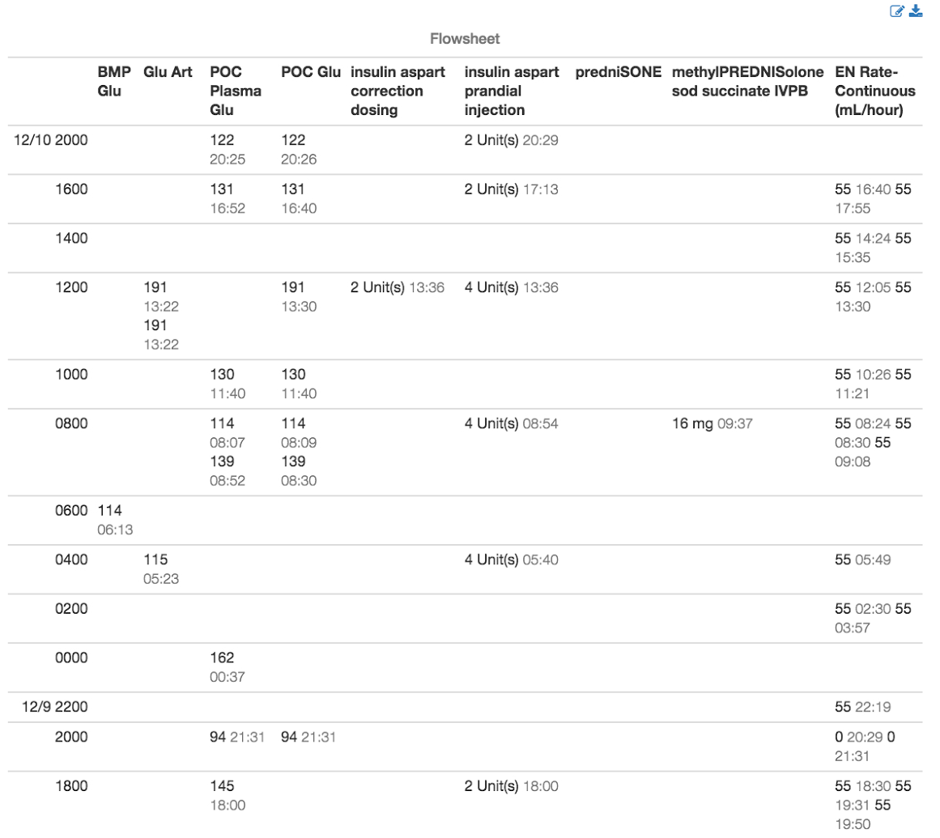
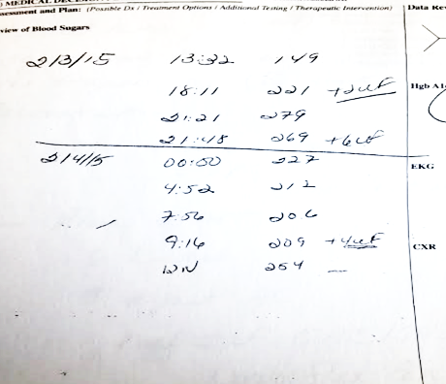
Purposeful Formatting
Current systems require manual data collection and restructuring for easiest interpretation.
Actionable Comparisons
Data from multiple sources are pulled together to tell a temporal story that can guide decision-making
Current manual reformatting || Automated reformatting
Endocrine

Slide 7
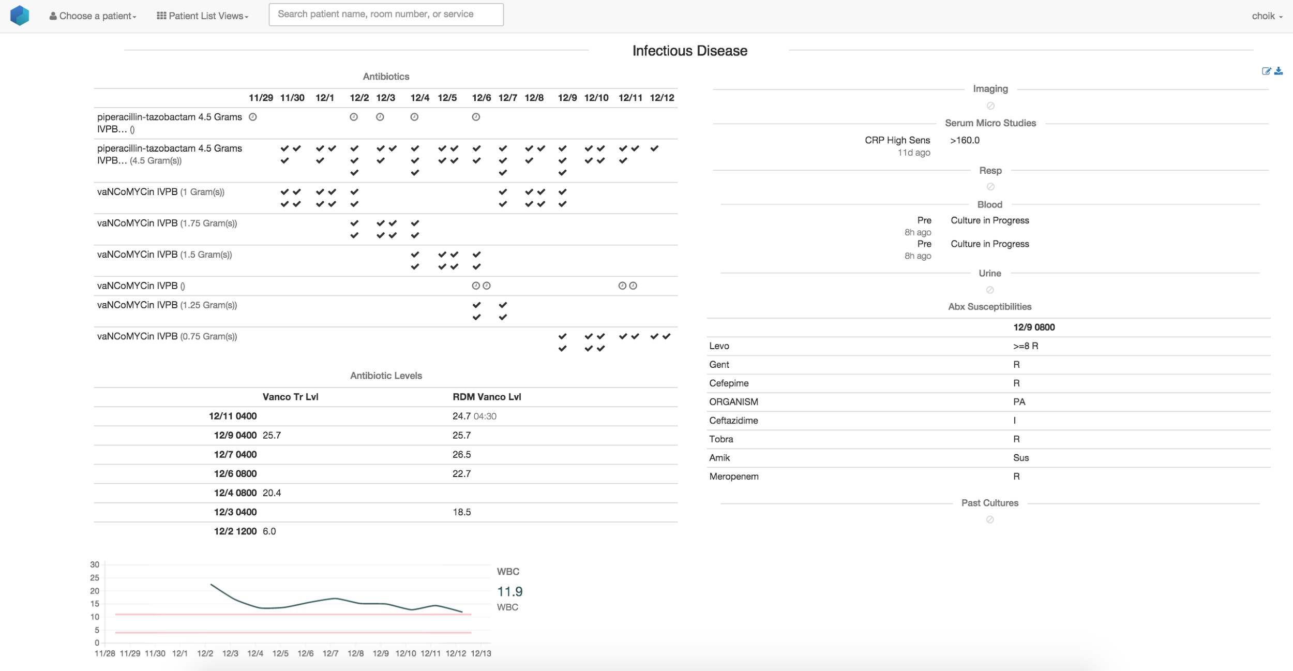
Cause and Effect
Improvements in response to antibiotics can be visualized. Regimens can be adapted effectively.
Infectious Disease

Slide 8
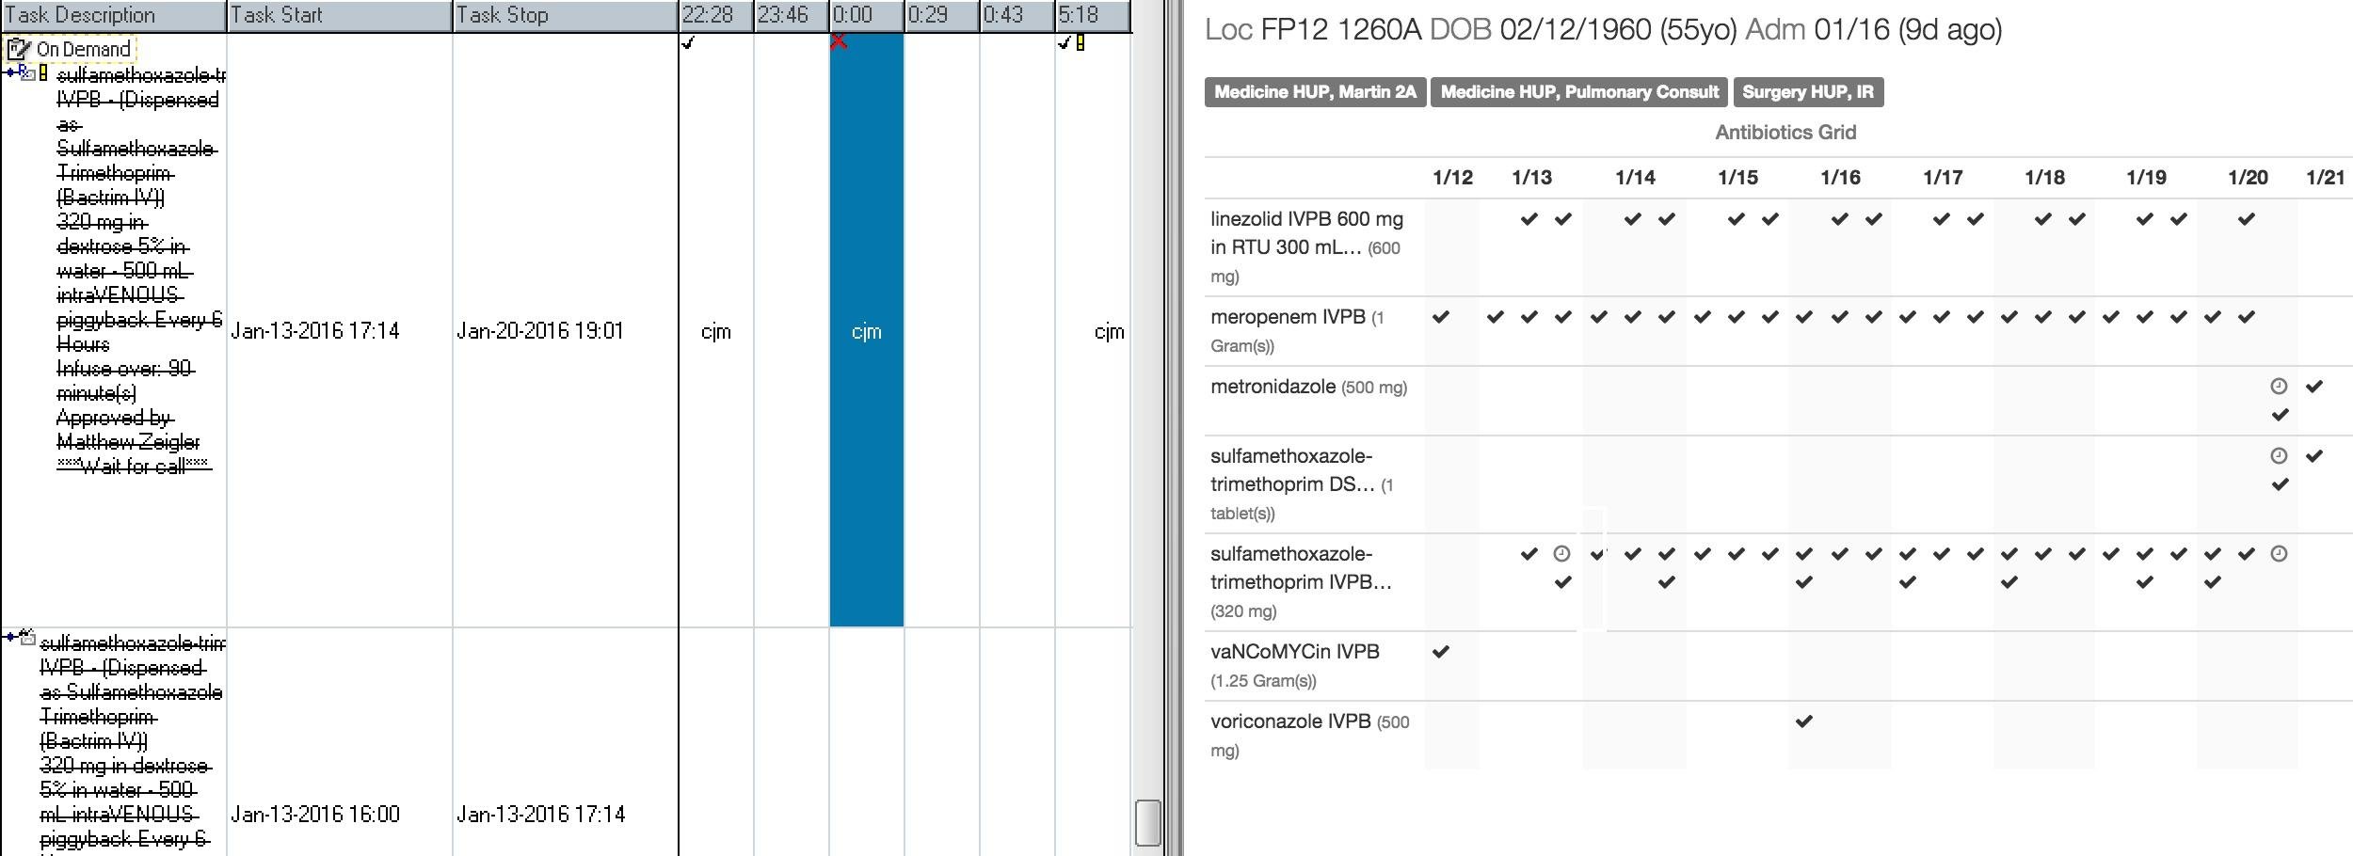
High Data:Ink Ratio
Utilizes screen real estate with dense, organized data, minimizing load on working memory. Details available with hover.
Allscripts || Dash
Medication Management

Slide 9
Quality and Task Management:
Census Management

Slide 10
Overview - Features & Flow

Slide 11
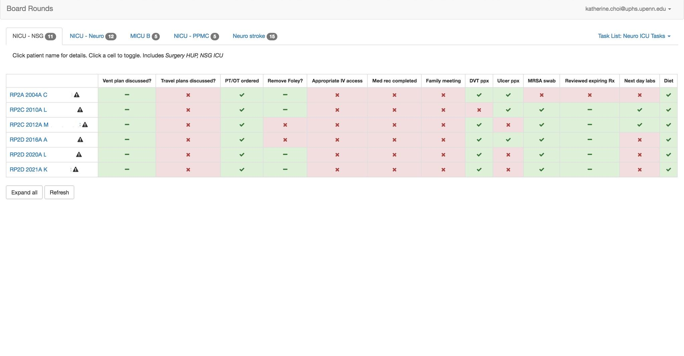
Key Quality Indicators
Service-level compliance can be viewed at a glance, with optional drill-down.
Quality Improvement Metrics

Slide 12
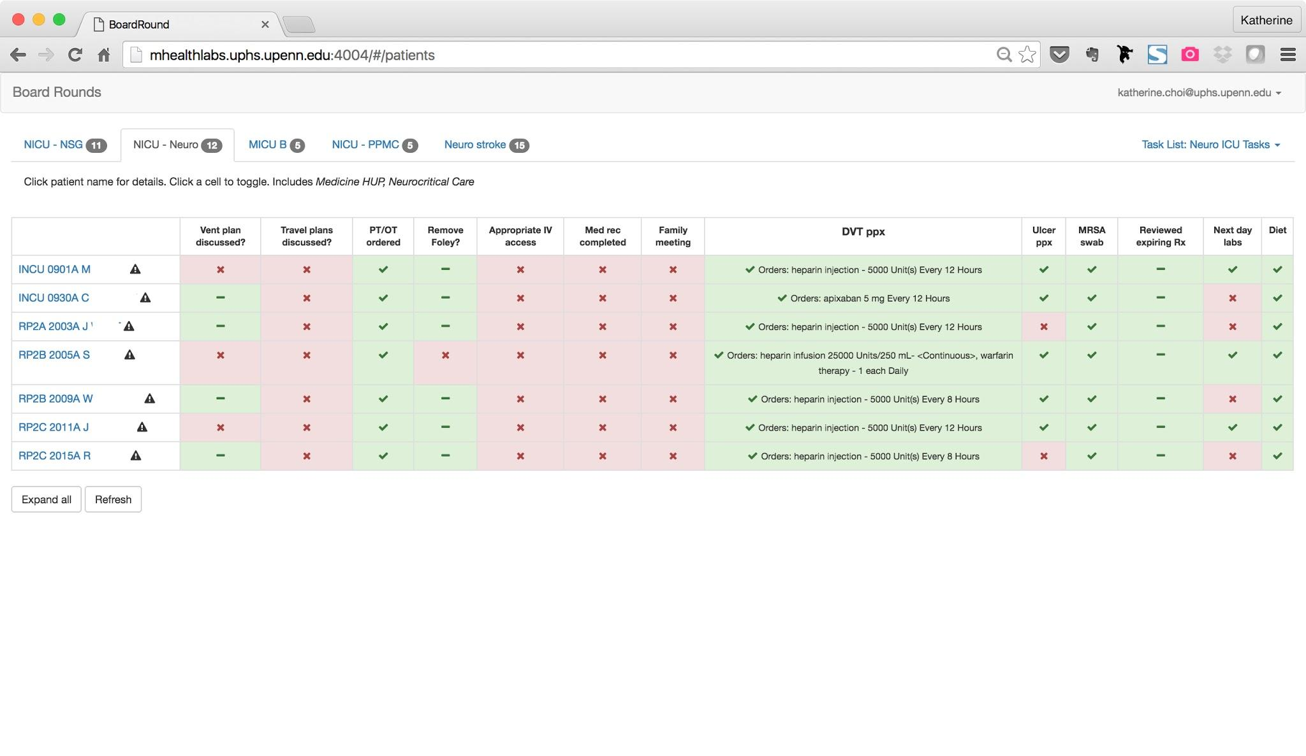
Drill-down
Details of compliance is expanded with one click.
Detail: DVT prophylaxis

Slide 13
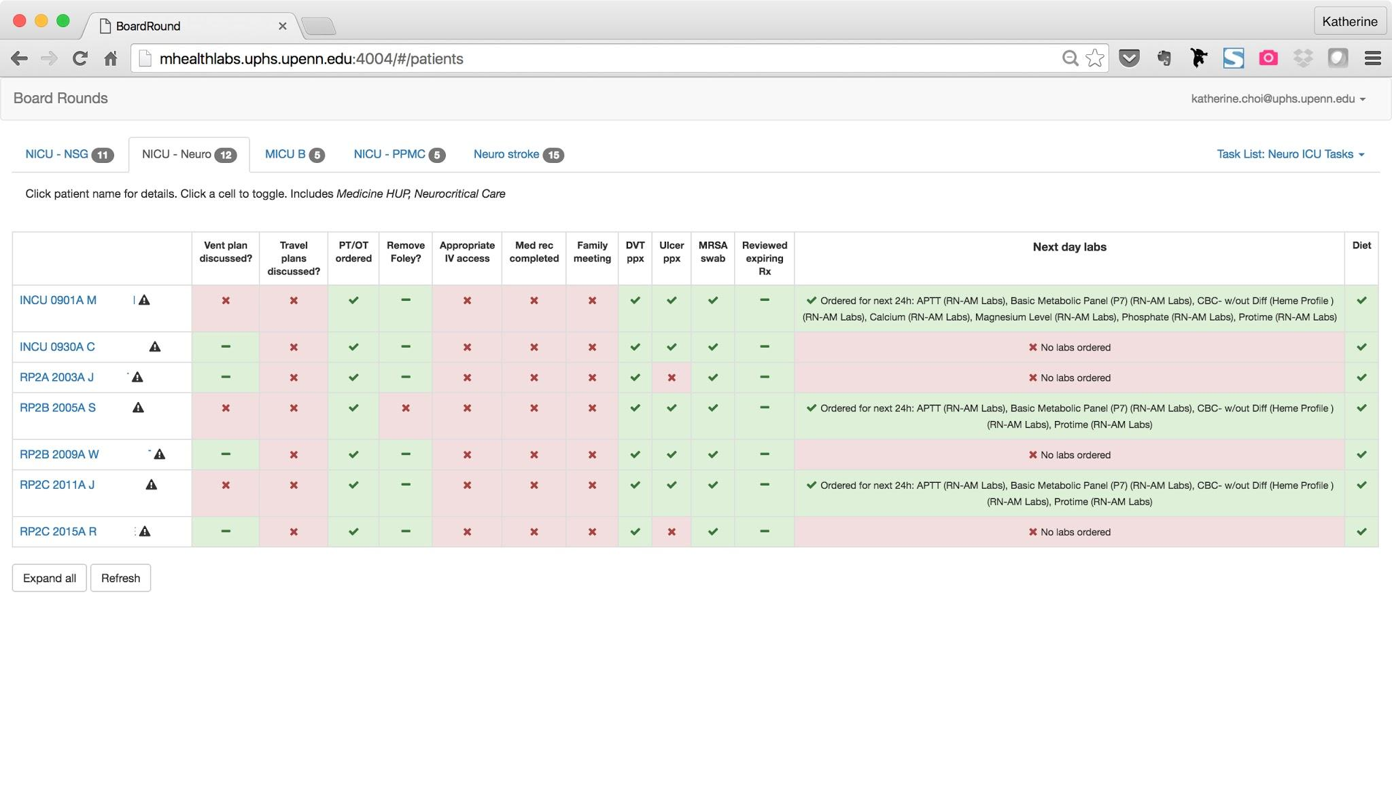
Interactive
Compliance can be checked off to indicate interventions taken throughout the day. Status resets every 24hrs.
Detail: Next day labs

Slide 14
Drill down view

